Slide 1
Datamining Methods

Slide 2
Example Dataset.
Categorical
Categorical
Numeric
Numeric
Variables
Date | Temp | Wind Dir | Evap | Rain?
10 Dec | 23 | NNE | 10.4 | Y
25 Jan | 25 | E | 6.8 | Y
02 Apr | 22 | SSW | 3.6 | N
08 May | 17 |  | 4.4 | N
Observations
Input
Output
Identifier

Slide 3
Data Issues
Data cleaning
Mistakes
Missing data
Difficult to deal with.
Depends largely on the type of data.
Outliers
Rescaling
A popular normalization step is to replace the original value with its z-score (standard deviations away from the mean).
Log transformation
Rank – replace the original value with its rank (values are simply integers)

Slide 4
Steps for Data mining
Dealing with Class Imbalance
Use a classifier that accounts for this
Balance the number of outcomes in output variable
Separate Dataset for Testing
Split into Training and Testing
Use K-fold Cross validation
Create the model using training dataset.
Evaluate the model using test dataset.

Slide 5
About the dataset
Date of birth: self explanatory
Marital status: 1=divorced/separated, 2=married, 3=single, 4=unknown, 5=widowed
Race: 1=black, 2=white, 3=other
Age at Diagnosis: self explanatory
Alive Status: 0 = alive, 1 = dead
Survival time= time from data of diagnosis
Grade: Tumor grade. 1=tumors with well differentiated cells (low-grade), 2=Intermediate, moderately differentiated, 3 and 4= high grade, most aggressive tumors and poorest prognosis.
Nodes examined: Number of lymph nodes examined
Nodes pos: Number of positive lymph nodes

Slide 6
Dataset contd.
Extent: extent of disease. 10=confined to breast tissue, 20=Invasion of subcutaneous tissue, 30=Invasion of pectoral muscle, 40=Invasion of chest wall and ribs, 50=extensive skin involvement, 70=Inflammatory carcinoma
Nodal Status: 0:No lymph node involved, 1:<0.2cm, 2:<2.0cm, 3:<2.0cm with extension beyond capsule, 4: >=2.0cm, 5:Fixed ipsilateral axillary nodes, 6: Axillary nymph nodes, 7: Internal mammary nodes, ipsilateral distant lymph nodes, 8: Cervical , 9:unknown (not stated)
Size: tumor size
pgr: 1=positive, 2=negative, 3=borderline
er: 1=positive, 2=negative, 3=borderline

Slide 7
Different methods
Unsupervised Learning
Clustering- Grouping of observations based on attributes. Data is not labeled.
Linear Regression
Relationship between observations or attributes
Supervised Learning
Classification of observation based on training set. The data is labeled.

Slide 8
Steps for Clustering
Calculate distance
In order to group similar observations or attributes we need to have a way to measure their difference
Euclidean
Pearson
Spearman
Group similar observations or attributes
K-means
Hierarchical
Determine quality of clustering
Silhouette plots

Slide 9
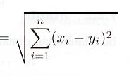
Euclidean Distance
Geometric difference
520
Gene expression
1090
experiments
expvalues.dist<-dist(expvalues, method=“euclidean”)

Slide 10
Correlation: Association between variables
Generally comparison is done on pairs of scores for two variables.
Pearson correlation:
If both variables are normally distributed we can assume linear relationship.
Spearman’s rank correlation
Non-parametric equivalent measure.

Slide 11
Pearson correlations
A linear relationship between variables can be visualized by drawing a straight line through the points on a scatterplot.
Line is drawn to minimize
distance between all pts.
Pearson correlation is the
measure of how close the
points are to the line

Slide 12

Pearson’s correlation
X are the different values for variable X,
X-bar is the average of X values
Y are the different values for variable Y
Y-bar is the average of Y values
The equation shows the covariance of the two variables divided by the product of their
Standard deviations.
Values range from -1 to 1
-1 is negative correlation,
+1 is positive correlation
0 is no correlation

Slide 13
Pearson correlation
Start with the concept of covariance
Cov_{xy}=
Implication for gene expression: the shape of gene expression responses will determine similarity
Σ (x_{i}-x)(y_{i}-y)
n
i=1
n-1
Normalize the measure by taking the variance of two measurements
VarX and VarY
√ (VarX)(VarY)
Pearson correlation has the nice property of varying between -1 and 1
-1
Gene expression
1
Σ (x_{i}-x)(y_{i}-y)
Pearson correlation coefficient
n
i=1
n-1
√ (VarX)(VarY)
experiments
expvalues.dist<-as.dist(1-cor(t(expvalues), method=“pearson”))

Slide 14
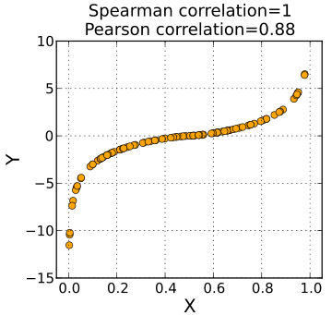
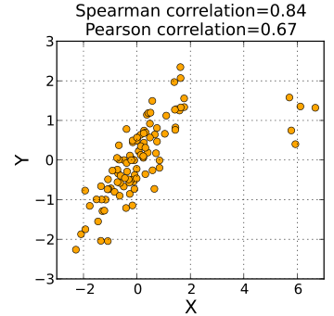
Spearman Rank Correlation
A pearson correlation of ranks.
Gives better correlation when relationship is not linear
Less sensitive compared to pearson in regards to outliers
expvalues.dist<-as.dist(1-cor(t(expvalues), method=“spearman”))

Slide 15
Hierarchical Clustering: Example
 | gene 1 | gene2 | gene 3
gene 1 | 1 | 0.5 | 0.8
gene 2 |  | 1 | 0.6
gene 3 |  |  | 1
Experiment 1
1
3
Experiment 2
Experiment 3
Experiment 4
Experiment 5
Experiment 6
Experiment 7
Experiment 8
Experiment 9
Experiment 10
Gene 1
Find cells with the shortest distance (e.g.,highest correlation)
Group the two genes
Recalculate distances from joined group to rest of matrix
Find next shortest distance
Repeat 3-4 until done
Gene 2
Gene 3
Gene 4
Gene 5
…
…
Gene 10,000
expvalues.hclust<-hclust(expvalues.dist, method=“average”)

Slide 16
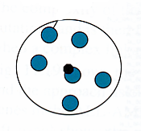
Some linkage methods
Single linkage
Complete linkage
Centroid linkage
Average linkage
expvalues.hclust<-hclust(expvalues.dist, method=“average”)
expvalues.groups<-cutree(expvalues.hclust, h=0.7)
expvalues.groups<-cutree(expvalues.hclust, k=10)

Slide 17
K-means
Decide how many clusters you want, K=n, (Principal components Analysis can help)
Step 1: Make random assignments and compute centroids (big dots)
Step 2: Assign points to nearest centroids
Step 3: Re-compute centroids (in this example, solution is now stable)
Optimize by maximizing distance between groups, minimizing distance within groups
expvalues.kmeans<-kmeans(expvalues.dist, 10)

Slide 18
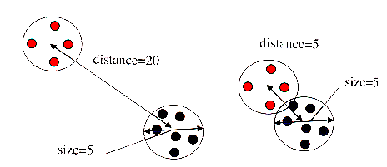
Judging the Quality of a Cluster
The idea is to classify distinct groups: other methods seek to directly optimize this trait in classification

Slide 19
Different methods covered in class
Clustering
Grouping of observations based on attributes.
Regression
Relationship between observations or attributes
Decision trees
Classification of observation based on training set.

Slide 20
Regression
Linear regression allows us to model the linear relationship between output variable Y and a predictor variable X.
Y = aX + b
Multiple regression allows us to model the linear relationship between output variables and two or more predictor variables.
Predictor variable do not have to be independent. We can model interactions between predictor variables.
Logistic regression
If our output variable is dichotomous, we may need to use logistic regression (probability of success)

Slide 21
What are something we would like to predict in Biology?
Transcription of the gene
What are its predictors?
Transcription factors
We can see expression of which transcription factor or transcription factors can best predict expression of a gene.
>exmodel<-lm(as.numeric(train.full$survivaltime) ~ as.numeric(train.full$size)+as.numeric(train.full$ageatdiagnosis)))
>plot(as.numeric(train.full$survivaltime)
>lines(as.numeric(predict(exmodel)))
>summary(exmodel)

Slide 22
What does the model provide?
Coefficients
Weight applied to the different variables to fit the model.
P-values
Significance of finding such a model. Does not pass cutoff for bad models.

Slide 23
Regression Test
lm() to create the model
predict() to predict the output variable given the input values.
resid() difference between predicted output and the observed output.

Slide 24
Logistic Regression
What if your output variable is not continuous, for example a variable that is binary or dichotomous.
Logistic Regression allows variables to be non-normal probability distributions.
Logistic Regression attempts to model probability of yes outcome using a linear function of the input variables.

Slide 25

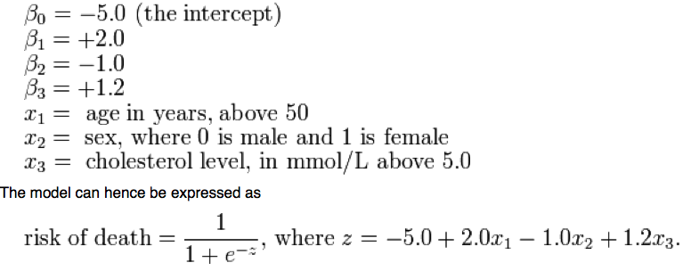
Logistic Function
http://en.wikipedia.org/wiki/Logistic_regression

